Slide 1
Exploratory Data Analysis in Python, R and SQL
An Introduction to Data Analytics and Data Science
By: Dorcas Mbaeri
Faculty Advisor: Dr. J. Patrick King

Slide 2
OBJECTIVES
Define Exploratory Data Analysis
Examine and explore how to do Exploratory Data Analysis
Evaluate the three different tools (Python, R and relational databases) for data exploration
Specify certain features or packages in Python and R useful for carrying out data exploration
Advantages and disadvantages of implementing relational database schema

Slide 3
DEFINITION
Exploratory Data Analysis (EDA)
Coined by John W. Tukey in 1977 in his book “Exploratory Data Analysis”
Important step before machine learning or statistical modeling
Objectives:
Maximize insight to data set
Uncover underlying data structure
Test underlying assumptions
Develop parsimonious models
Determine optimal factor setting

Slide 4
DEFINITION
Types of data that might affect what EDA technique to use
Structured
High degree or organization
Numerical or categorical data
E.g. phone numbers and gender
Unstructured
E.g. photos, images, audio, language text (free text)
Simply not structured
Uses deep learning algorithms to work with such data

Slide 5
STRUCTURED DATA
Categorical statistical visualizations:
Frequency plots/tables
Pie charts
Bar charts
Numeric statistical visualizations:
boxplots
Bar charts
Histogram
Summary/descriptive statistics
Mean, median, mode, min/max, standard deviation, variance, percentiles, coefficient of determination

Slide 6
MAKING ASSUMPTIONS FOR ANALYSIS
Two types of assumptions that can affect the validity of analysis: technical and business
The validation of these assumptions affects the predictive models and interpretation produced to answer business-related or specific problem
If not accurate, could result in poor predictions and incorrect conclusions
Data scientist/analyst get better view of data definition/structure after validation

Slide 7
TECHNICAL ASSUMPTIONS
Assumptions are assessed to help determine appropriate analytical models and algorithms
No collinearity between variables
Variance in data that is independent of the data’s value
Missing or corrupted data
Assumption without validation is a danger zone.

Slide 8
BUSINESS ASSUMPTIONS
Bit more elusive or intuitive than technical assumptions
Can be deeply entangled with the problem and how it is framed
Analysts may already have experience in the applicable industry or business field so assumptions may stem from experience
Assumption without validation is a danger zone.

Slide 9
TOOLS FOR DATA EXPLORATION
R
Python
Relational data model (SQL)

Slide 10
R
Open-source statistical programming (and interpreted) language
Originated from programming language called S in 1970s
Developed by John Chambers & co. at Bell Laboratories
Designed for statisticians and data scientists to perform standard and advanced algorithms
Linear and non-linear regression, time-series analysis, clustering, random forest, structural equation model, penalized regression

Slide 11
R
Useful features of R
RStudio
R Markdown
ggplot2

Slide 12

RStudio
Most popular integrated development environment (IDE) of R
For statistical computing and graphics
Free and open-source
Accessible from several scripting languages, such as Python
Interactive component: R Markdown

Slide 13
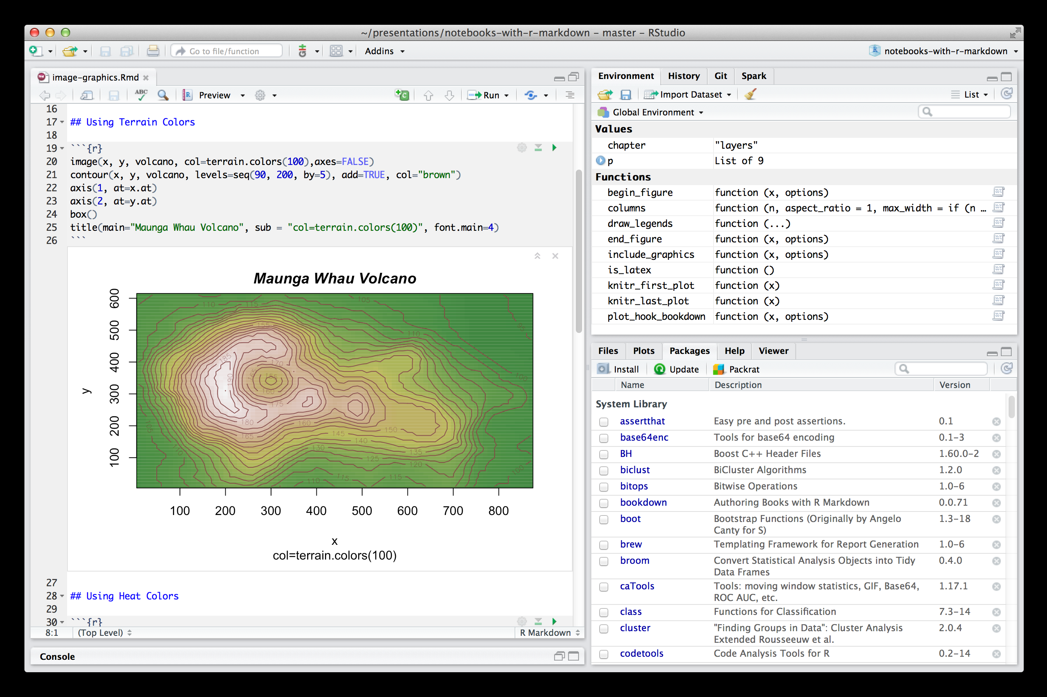
R Markdown
R version of markdown that allows for easy-to-read, easy-to-write plain text format
Essential features include:
Output to HTML, PDF or Word document;
Interactive documents;
Version control;
Integrated with R Studio;
Free web publishing with R Pubs

Slide 14
ggplot2
Powerful data visualization R package
Developed by Hadley Wickham
Based on Grammar of Graphics by Leland Wilkinson
Allows for easy generation of graphics that represent both univariate and multivariate numerical and categorical data

Slide 15
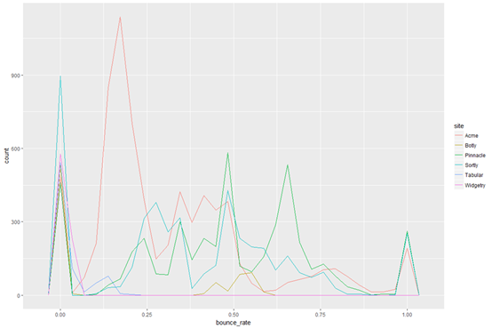
ggplot2 (continued)
Grouping visualization using colors, symbols, size or transparency
Components
Data, aesthetic mapping, geometric object, statistical transformations, scales, coordinate system, position adjustments and faceting
No methods included in the package
Direct implementation of graphical features (boxplot, frequency plots, histogram, etc.)

Slide 16
PYTHON
Scripting programming language (also open-source)
Has a large data science community and most preferred for beginners to learn due to clear readability
Powerful third-party packages:
NumPy (manipulation of homogenous array-based data)
Pandas (manipulation heterogeneous and labeled data)
Matplotlib (publication-quality visualizations)
IPython/ Jupyter Notebook (interactive execution and sharing of code)

Slide 17
NumPy
Numerical Python (NumPy) is a foundational package for scientific computing in Python
Built on numerical arrays
Efficient data storage and manipulation of dynamically growing big data
Arrays form the core of entire ecosystem of data science tools in Python

Slide 18
NumPy (continued)
Useful application:
Functions for performing element-wise computations with arrays or mathematical operations between arrays
Tools for reading and writing array-based data sets to disk
Fast and efficient multi-dimensional array object – ndarray
Linear algebra operation,
Fourier transformation
Random number generation
Tools for integrating C, C++ and Fortran code to Python

Slide 19
Pandas
Built on top of NumPy
Primary object is DataFrame
Two-dimensional tabular, column-oriented data structure with rows and column labels
Works well with missing values, grouping data, pivots, and more
Sophisticated indexing for reshaping, slicing and dicing data set
Selection of subsets of data

Slide 20
Matplotlib
Most popular data visualization package in Python
Developed by John D. Hunter in 2002 as a patch to IPython for enabling interactive MATLAB-style plotting via gnu plot from IPython command line
Comfortable interactive environment for plotting and exploring data

Slide 21
IPython and Jupyter Notebook
IPython
Interactive interface of Python
Enhanced shell designed to accelerate the writing, testing and debugging of code
Jupyter Notebook (or Project)
Browser-based notebook of IPython
Good for development, collaboration, sharing and publication of data science results
Useful when pairing with visualizations from matplotlib graphics

Slide 22
RELATIONAL DATABASES
Powerful storage units that can be used for data analysis
Includes complex or simple relationships between multiple tables
Independent of application layer
Structured Query Language (SQL) is the programming language commonly used to communicate with relation databases

Slide 23
SQL
Used to add, delete, extract, modify or operate on any information within the relation database
Can be used for advanced analytics and can change the structure of the database itself
Several “flavors” or variations of SQL:
PostgreSQL
Procedural Language/ SQL (PL/SQL)
Transact-SQL (T-SQL)
The ANSI standard SQL

Slide 24
SQL (continued)
SQL statements specify WHAT data operations to perform and not HOW to do them
Commands can be more concise than conventional programming languages
Advanced queries can be shorter compared to Python or R
Frameworks:
Projection, filters, joins, aggregation

Slide 25
SQL – PROJECTION
Extract columns of interest within the table using the SELECT clause
Example:
SELECT my_year, data_month, data_week, data_day, day_of_week
FROM dbo.myData

Slide 26
SQL - FILTERS
Specifies rows of interest using the WHERE clause
Example:
SELECT data_month, product, item_number
FROM dbo.myData
WHERE orders > 30000

Slide 27
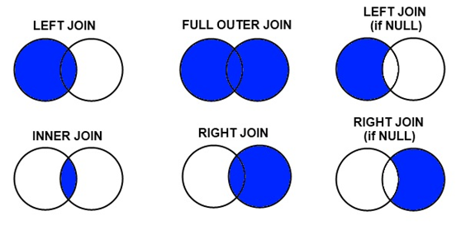
SQL - JOINS
Combines two tables based on shared key attributes in the tables and involves several ways to join
Inner join, full outer join, outer left join, outer right join, cross join

Slide 28
SQL – AGGREGATE OPERATIONS
SUM
COUNT
MAX
MIN
AVG
GROUP BY
HAVING

Slide 29
SELECT visit_site, user_platform, CEILING(AVG(search_page_views)) AS Average_Page_Views, CEILING(AVG(bounces)) AS Average_Bounces,
CEILING(AVG(add_to_cart)) AS Average_Add_to_Cart
FROM dbo.myData
WHERE user_platform IS NOT NULL
GROUP BY visit_site, user_platform
ORDER BY visit_site, user_platform
HAVING visit_site <> ‘’

Slide 30
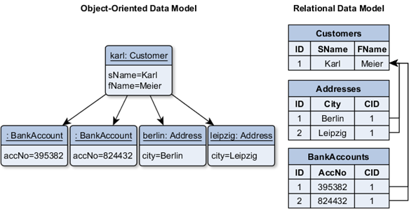
DISADVANTAGES OF RELATIONAL DATABASES
Not ideal for object-oriented data models

Slide 31
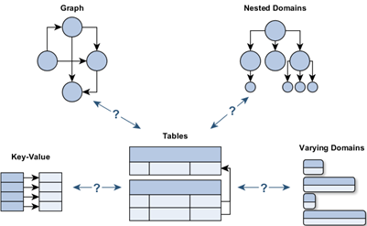
DISADVANTAGES OF RELATIONAL DATABASES
Data models that require large number of joins to fully traverse the schema
Can be messy, confusing, expensive and affect structure of stored procedures, views, etc.

Slide 32
ADVANTAGES OF RELATIONAL DATABASES
Allows for consistent, isolated and durable storage of big data
Data safety sue to defined schema and strict constraint checks (i.e. column types, uniqueness constraints, referential integrity)
Sever toolkits:
Triggers, stored procedures, advanced indexes, views and more

Slide 33

THANK YOU…
Dr. King (my advisor)
Dr. Redl & Ms. Nakamura for their support
Department of Mathematics and Statistics (Ms. Russell) for allowing me to print A LOT of pages for my full paper report
Student audience and professors (yes YOU)

